Slide 1
Classroom study of collaborative information analysis

Slide 2
Research questions
How do teams conduct information collection and information schematization when the two features are integrated in a single environment?
How do teams stay aware in a complex information analysis task?
What is the effect of collaborative instruments on information analytics education?

Slide 3
Rationale: information collection and schematization
We define information analysis as three activities: information collection, information schematization, and hypothesis generation (Pirolli2005, Kang2014)
Most research investigates into and designs for one activity only
Information collection: information seeking tools
annotation
Highlight
Adding metadata
Categorize as a type of entity, person,
Information schematization: interactive visualization tools
Hypothesis generation: ACH
Information schematization: annotation,
Views of schema: visualization,
hypothesis
This paper focuses on information collection and information schematization, and explores human behavior shaped by the integration of the two features in a single workspace.
Empirical study found analysts constantly collect more data as they reframe the problem (Stasko2008)
“Dynamic data processing and visualization” - one of top ten needs for intelligence analysis tools based on feedback from a workshop of intelligence analysis professionals (Badalamente2005)
Notes:
Stage model and interleave model
Discuss stage model separate state – transition, oversimplified model

Slide 4
Rationale: Awareness support
Limit of prior research in two aspects:
Tasks are not complex enough. 1) usually one-hour lab task. 2) participants work with a single artifact (e.g. a map in map editing, Fechner2015; a coding base in programming;
When task complexity increases, team members requires higher awareness to stay coordinated while less cognitive ability to obtain awareness
Awareness features are investigated separately (e.g. implicit sharing of hypotheses, Goyal2014; display of details of history, Marlow2015; display of brushing actions, Hajizadeh2013)
However, these works provide little information on how they support real world teams when put together
We develop several awareness features and deploy the tool in real world classroom projects

Slide 5
Rationale: Learning information analytics
Martin (2014) called for enhancement of intelligence analysis training methods, to incorporate innovative tools in teaching and learning
Vision 2015 from Director of National Intelligence noted the intelligence community shifting from self-reliance towards more collaborative operations
We integrated the collaborative tool into the course project as a first step exploring “innovative computational infrastructure”

Slide 6
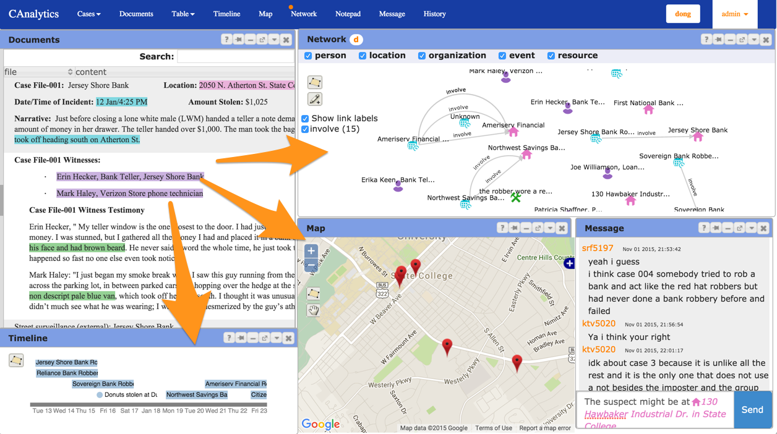
Method
CAnalytics features
Data annotation to collect and model data
Coordinated multiple views to support analysis
Awareness features
Real time sharing of user generated data
Tool coordinator
Notification
Team history
Chat and shared text editor

Slide 7
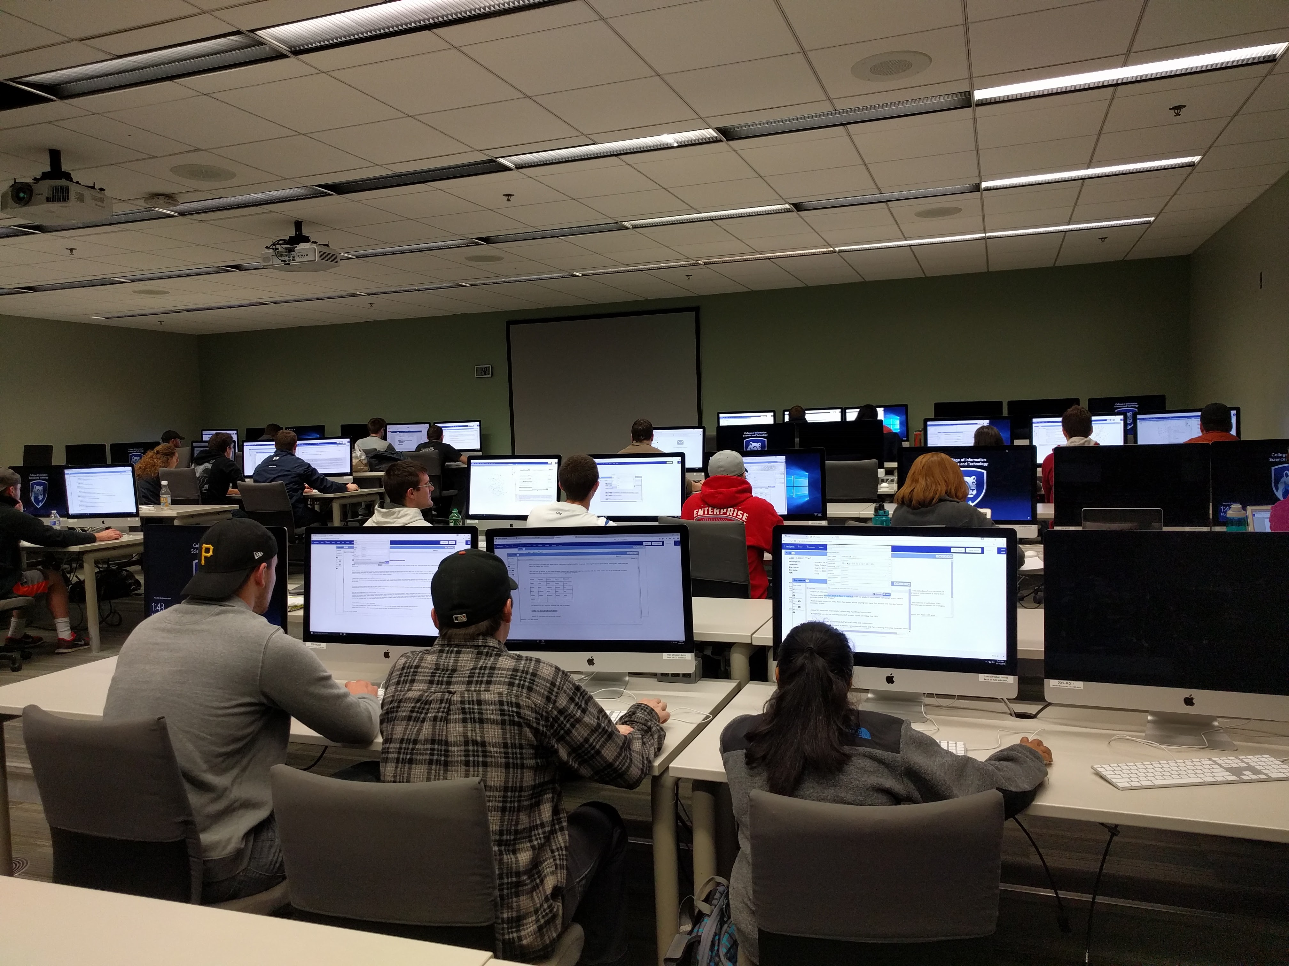
Method
Undergraduate course in Program of Security and Risk Analysis at Pennsylvania State University, USA
73 students participated (25 teams)
22 teams data analyzed (2 teams consisted of two members, 1 team did not use much CAnalytics)
One-week-long intelligence analysis project

Slide 8
Result - data modeling
Teams created 1805 entities (mean = 82) and 1529 relationships (mean = 69.5)

Slide 9
Result – data analysis
Network view
light use
Separate clusters
Connected clusters
One big cluster

Slide 10
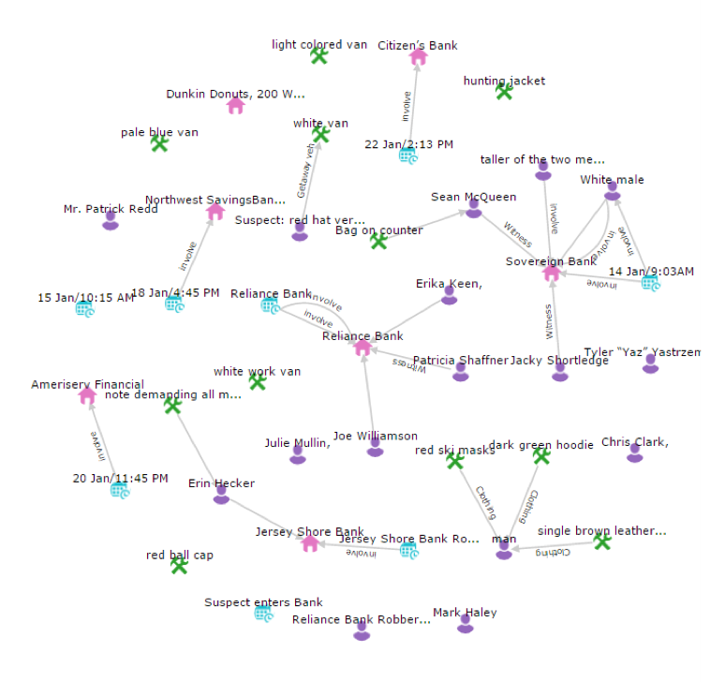
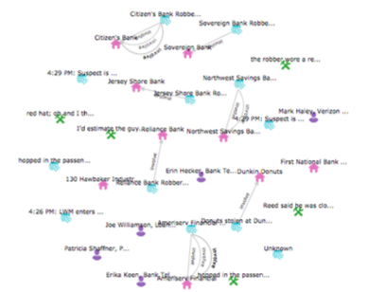
Examples of visual artifacts
less connected (6 teams, mean perf = 8.58)
G110
G80
Notes:
Selective
Node as external memory, and they purposefully keep it simple
Start generating hypothess earlier

Slide 11
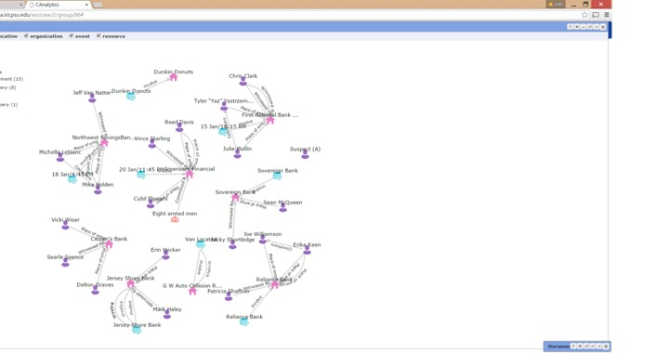
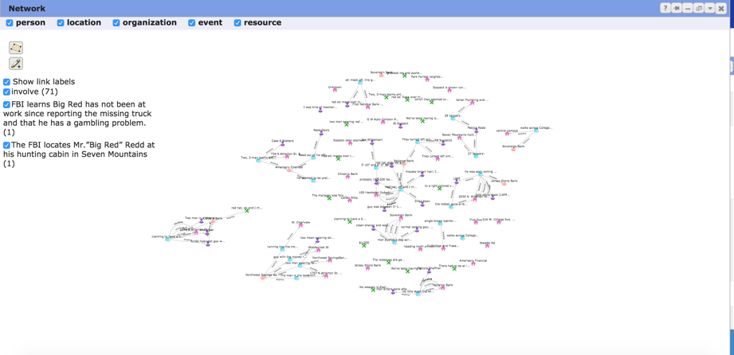
Examples of visual artifacts
Separate clusters (8 teams, mean perf = 7.88)
G86 (4.5)
G104 (14)
G108 (9)
Notes:
Literal
Richer graphic language
Complementary view
Separation of data nd
Different stage
Multiple view reduncy

Slide 12
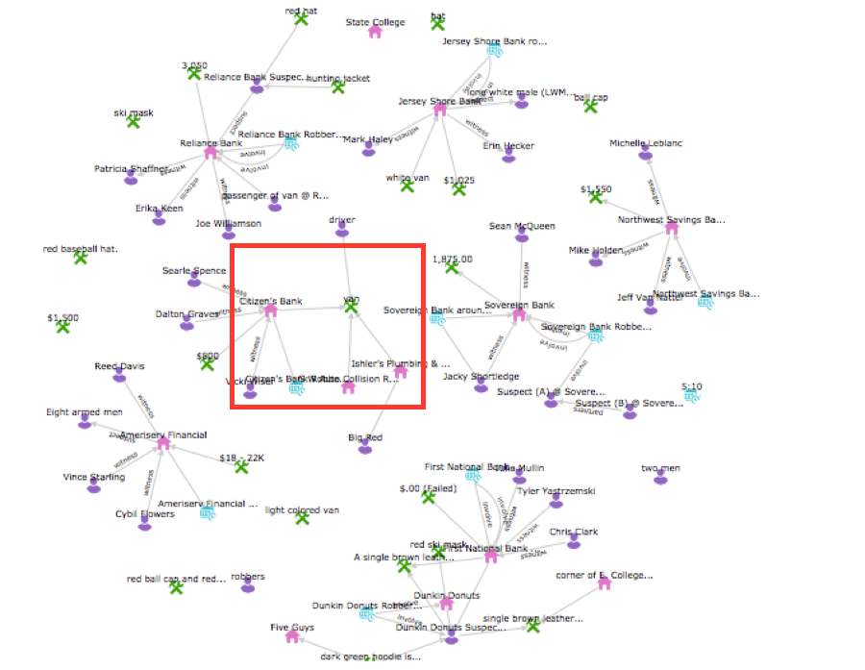
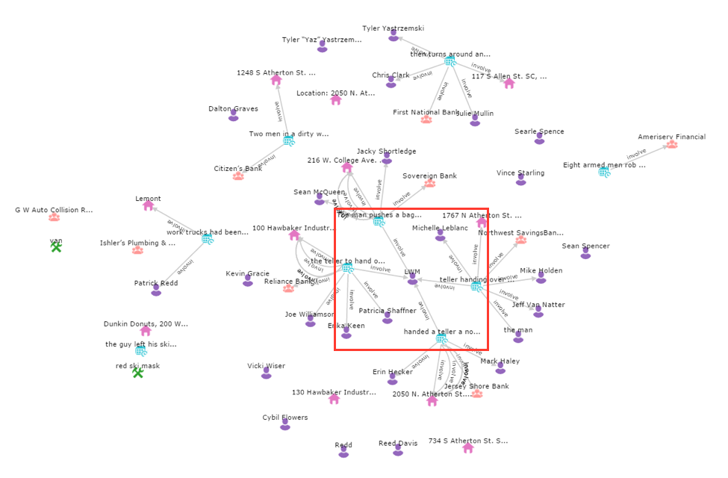
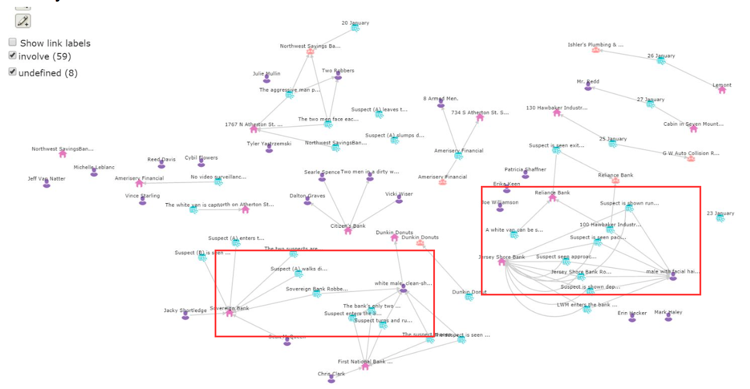
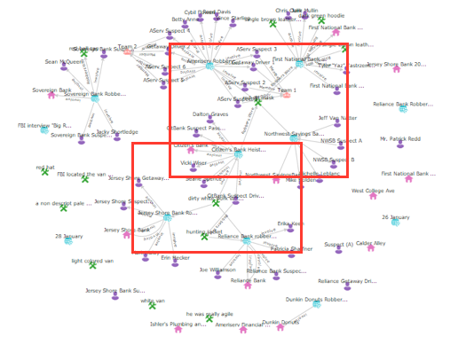
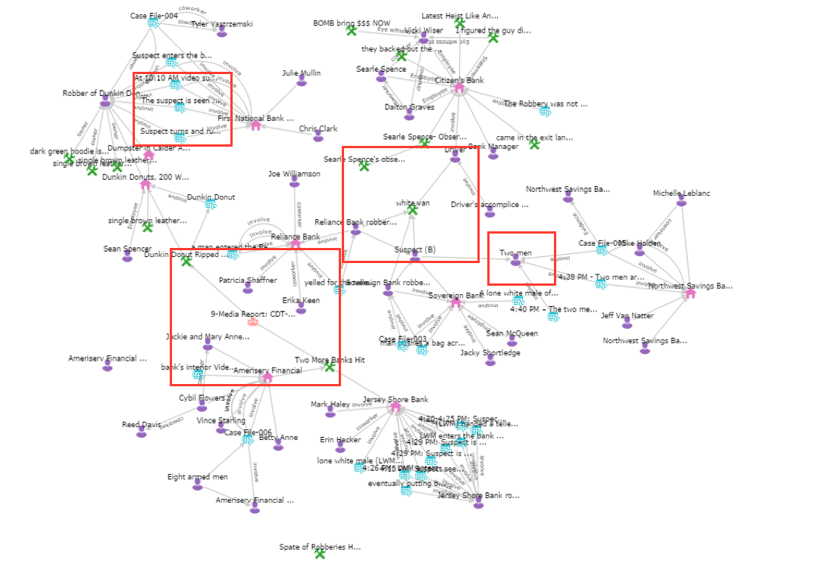
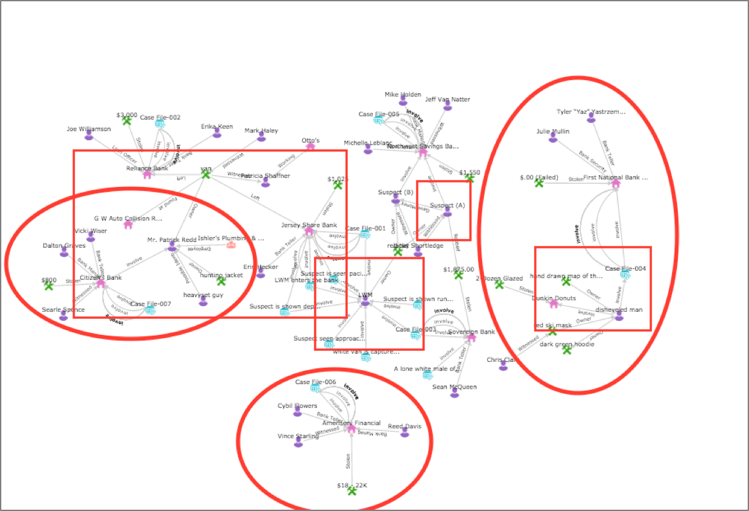
Examples of visual artifacts
Connected clusters (6 teams, mean perf = 8.3)
G101 (6)
G89 (6.5)
G85 (7.5)
G92 (8)
G77 (9.5)
G107 (12.5)

Slide 13
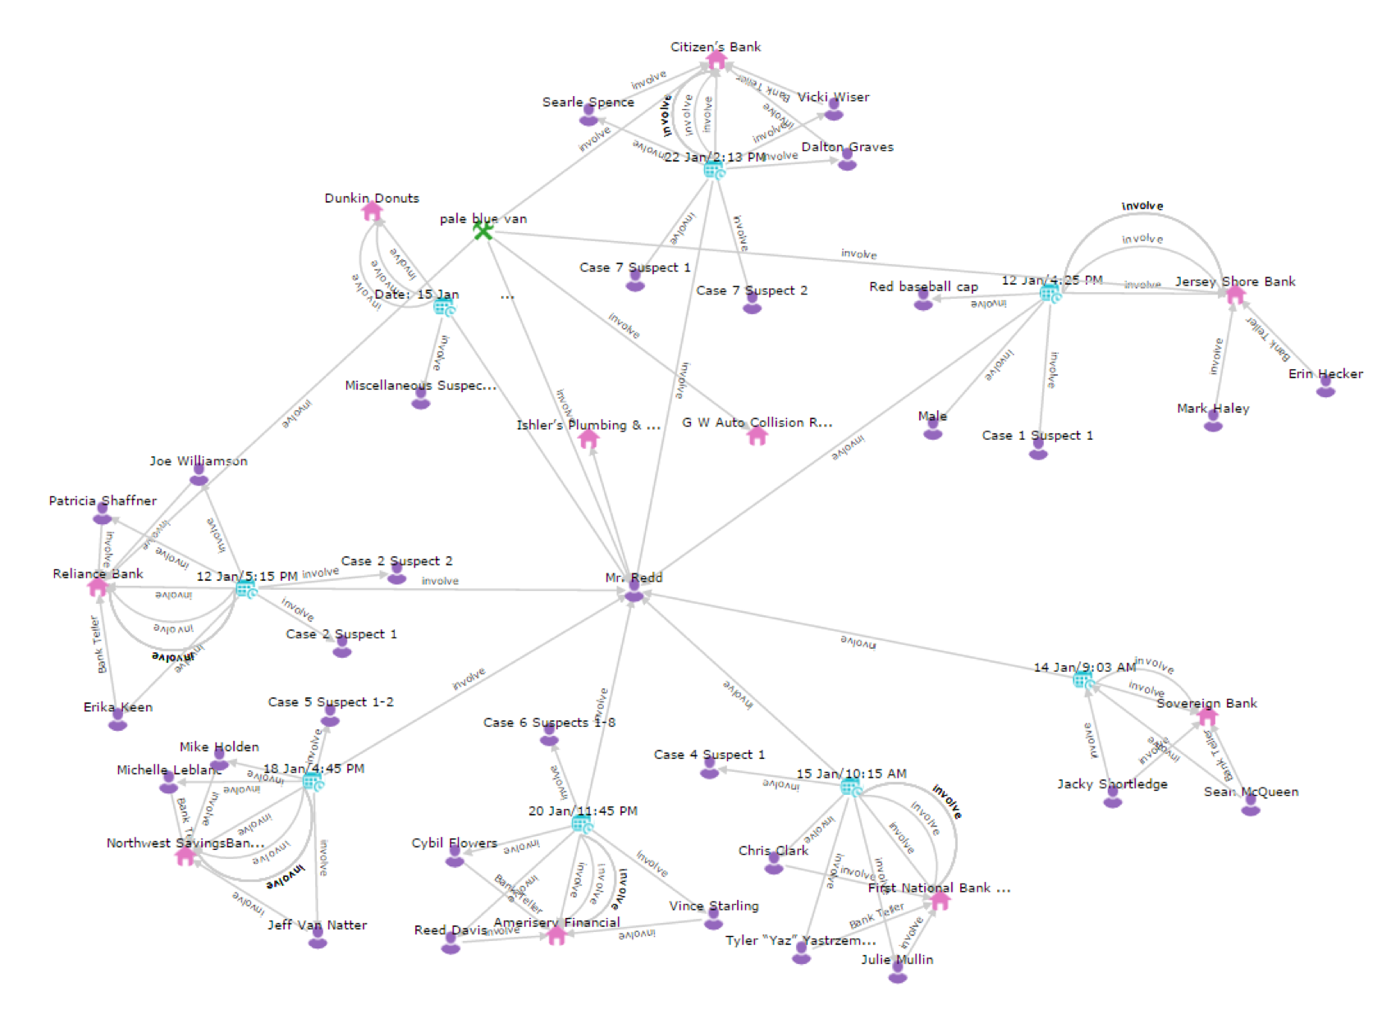
Examples of visual artifacts
One big cluster (2 teams, mean perf = 3.75)
G79
G84
Notes:
Provenance

Slide 14
Teams that created connected network performed better than those that created separate network. Yet some separate network teams also performed well, and some connected network performed poor. Why?
Why did teams that created separate network performed equally well? How did they identify the connection between cases?
While they kept their network separate, they used notepad to keep track of key information of cases (e.g. G104, G87)
Why did teams that created connected network performed poor? Where did they do wrong? (e.g.
They mixed inference with fact. The links in the network are treated equally, although being of various uncertainty

Slide 15
Uncertainty
Two ends in dealing with team uncertainty
Keep facts and inference in separate artifacts
Treat facts and inference indifferently
Design implication: addressing team uncertainty

Slide 16
Discussion
Data modeling affects data analysis, and vice versa (waterfall software development analogy)
Design for team uncertainty
Collapsible data model (unit of data modeling and unit of data analysis)

Slide 17
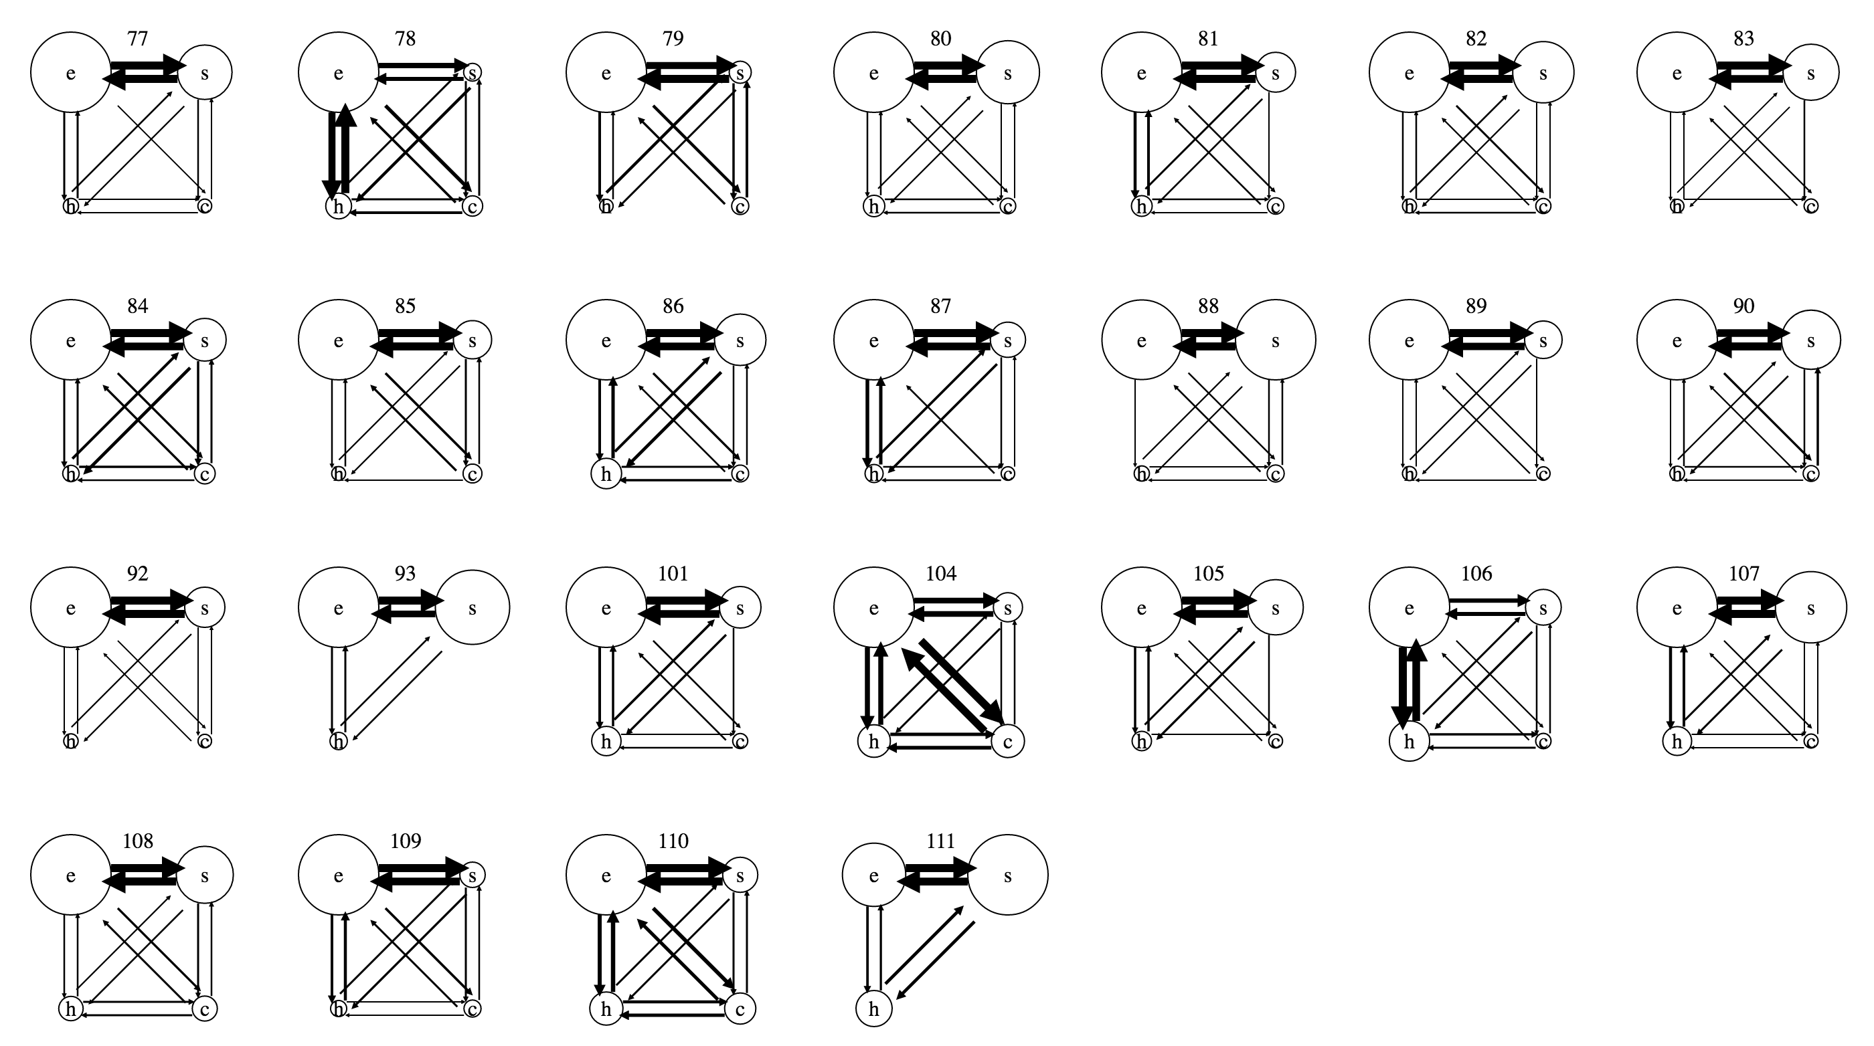
State transition

Slide 18
Result – patterns of information collection and analysis
Problem:
Matching the unit of collection and the unit of analysis

Slide 19
Result - awareness
Summary of survey items

Slide 20
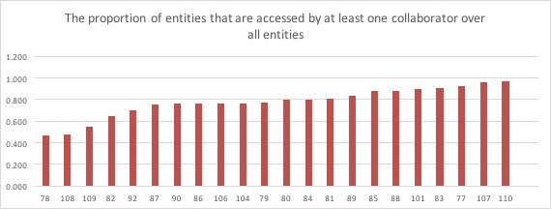
Result – awareness
From log analysis
In average, 77.6% of the created entities were accessed by at least one collaborator
Entity access

Slide 21
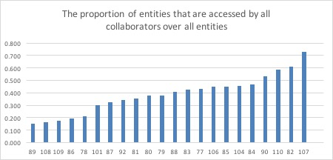
Result – awareness
From log analysis – entity access by all collaborators
Entity access

Slide 22
Result – awareness
The modifications to others’ work versus one’s own work. This is an indicator of territoriality, a phenomenon of social process blocking. Team 107 and Team 104 scored highest in this value, and they happened to be the highest performance teams.

Slide 23
Result – awareness
Student feedback

Slide 24
Result – experience of learning
Student feedback

Slide 25
Result – experience of learning
Change of behavior in the process
Strategy change: e.g. labor divided by document vs. divided by clues
Realize importance of structuring problem first (e.g. a team started collecting all information without framing the problem, and realized later that they collected too much noise)

Slide 26
Result – interaction with performance

Slide 27
Discussion – reflection on method

Slide 28
Discussion – iterative collection and analysis
Information analysis is a process of framing and reframing questions, requiring dynamic data inclusion to fill in knowledge gaps
Analogy to waterfall software development

Slide 29
Discussion – view sharing and control
Common approaches to view sharing
Shared visual artifact (e.g. collaborative editor)
Private vs public view
They are non-applicable to collaborative information analysis because
Multiple views/artifacts involved
Simultaneous control/contribution required
Tension between immediate sharing and information uncertainty

Slide 30
Discussion – instrument for teaching
Stream student logs to the instructor for early intervention
Log helps student be self-conscious about the analysis process (Heuer2002)

Slide 31
Usage overview
Entities created (graph)
Survey graph
Student feedback (analyst’s google doc)
-> dis: successful in general
Data modeling and analysis
Network analysis
importance of connector
-> dis: modeling affects analysis, modeling for uncertainty
Critic: Unit of modeling and unit of analysis (plus student feedback)
-> dis: collapsible data model
Accretion vs filtering strategy
State transition (graph showing modeling and analysis are interwoven)
-> dis: analogy to waterfall software design
Awareness
Survey graph (positive awareness)
Log (entity access) showing positive awareness
Student feedback
mentions of awareness features
Critic: Sharing of intermediate analysis status
Experience
Student feedback

